Slide 1
Tools and Equipment
National Junior Swine Association
Skillathon Resource

Slide 2
Learning Objectives
This resource should teach you how to identify tools and equipment that are utilized in the swine industry.
Upon completing this resource, you should be able to:
  Identify the tool or equipment by its correct name
  Understand the purpose for the tool and its use in the industry
  Comprehend how to safely and effectively utilize the tool

Slide 3
Ear Notcher
The ear notcher tool is used to notch the ears of baby pigs.
Ear notching is used to identify the pigs.
Ear notching is typically done within 7 days of birth, and is often accompanied with iodine to prevent any infection from occurring.
**You can learn more about how to ear notch and how to read ear notches
in the section titled “Ear Notching”.

Slide 4
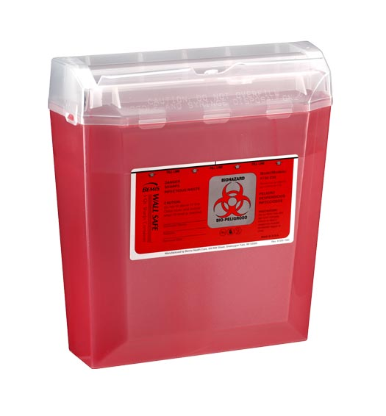
Syringe/Needles
Syringes are used to administer medications to animals.
They are typically plastic and have measurements down the side to properly measure the correct dose of medicine.
It is extremely important to replace the needle after using and to place old needles in a safe, puncture-proof sharps container.
Syringe
Sharps Container

Slide 5
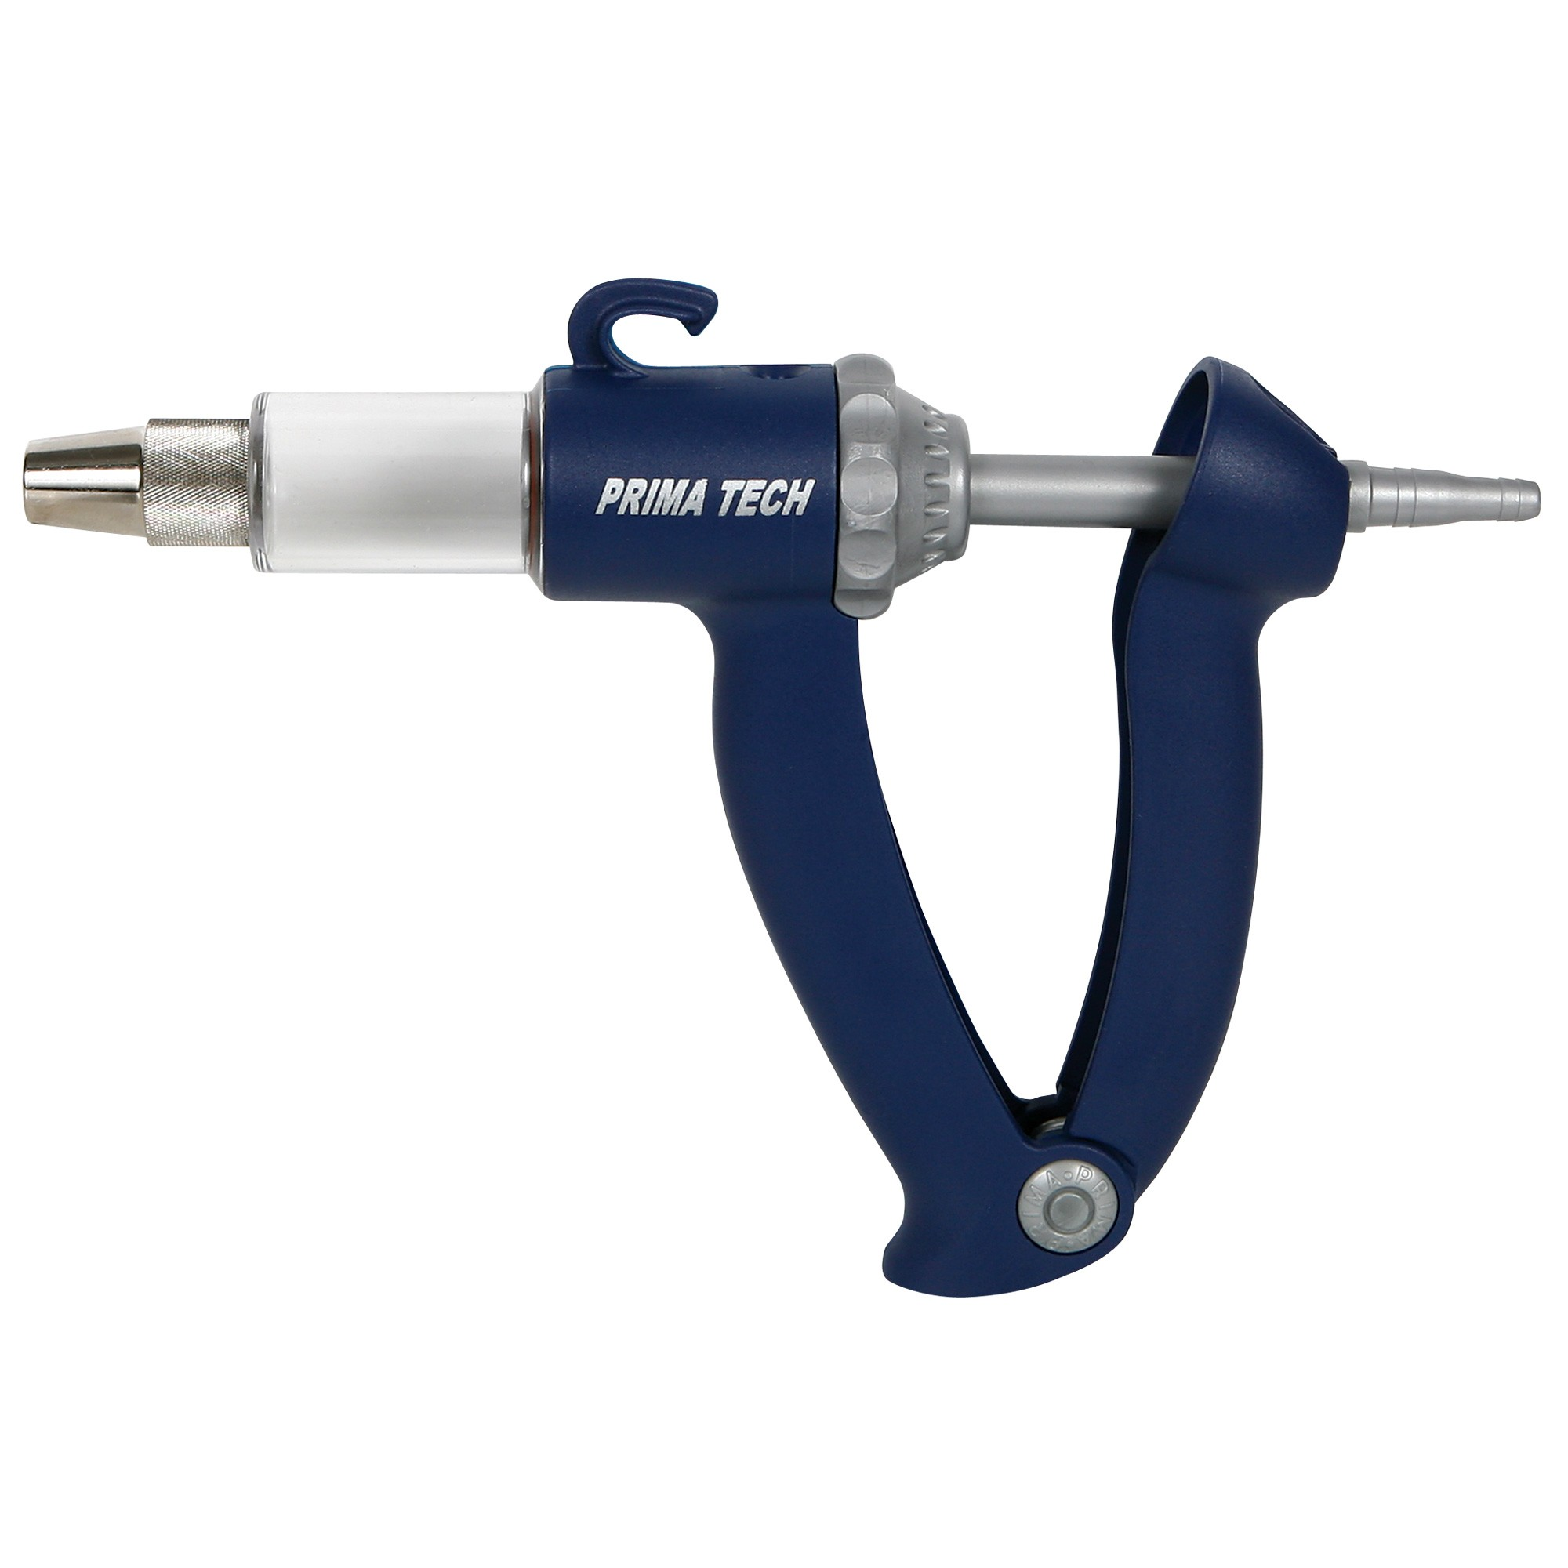
Dose Injector
A dose injector is a safe way to ensure that each animal gets the proper dose.
Since human error can lead to the use of both too much and too little medication, a dose injector can be programmed to allow a producer to use medications effectively.

Slide 6
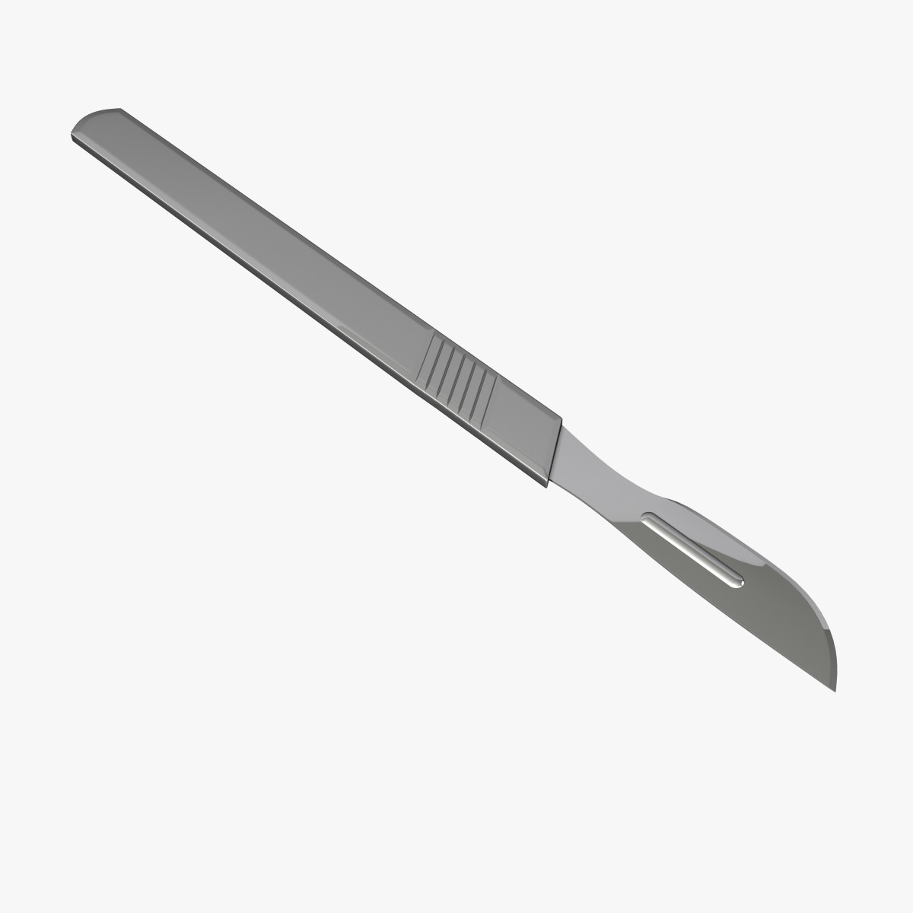
Scalpel
A scalpel is a common tool that is used in castration.
The scalpel is used to make either two vertical cuts or one horizontal cut to the scrotum followed by cutting the spermatic cord and removing the testes.

Slide 7
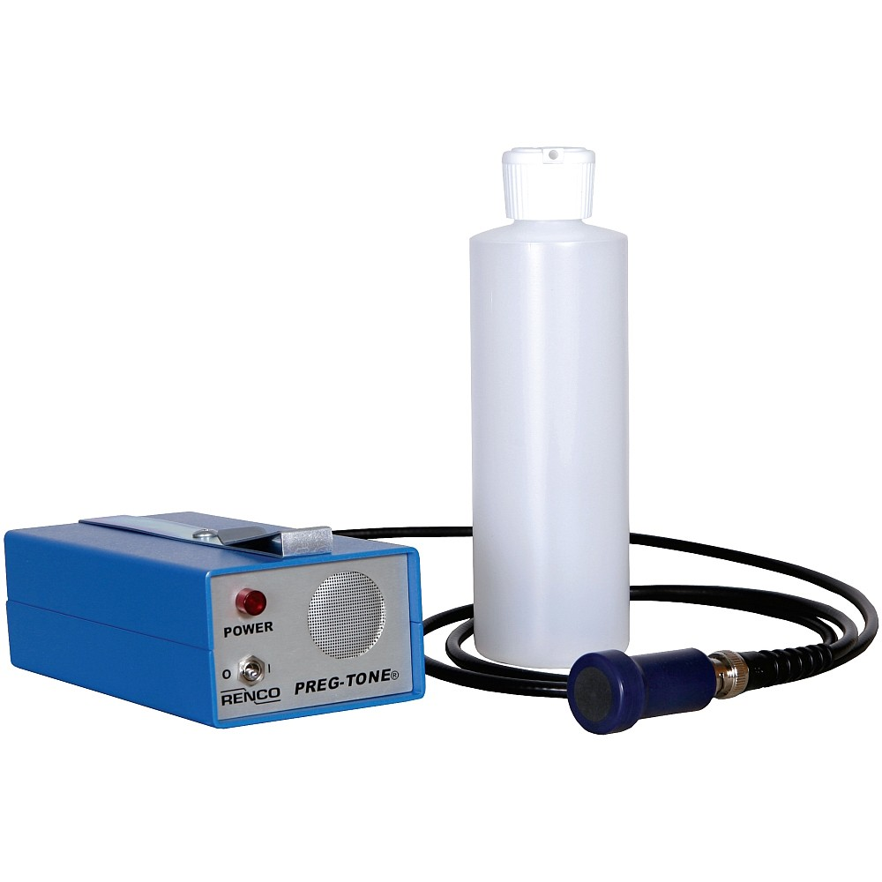
Preg-Tone
Preg-tone is an ultrasonic pregnancy detector.
It uses ultrasound to detect amniotic fluid present during pregnancy.
When this fluid is detected, the instrument produces a loud, continuous tone, indicating that the animal is pregnant.
If the animal is not pregnant, it produces an intermittent (static) recurring tone.

Slide 8
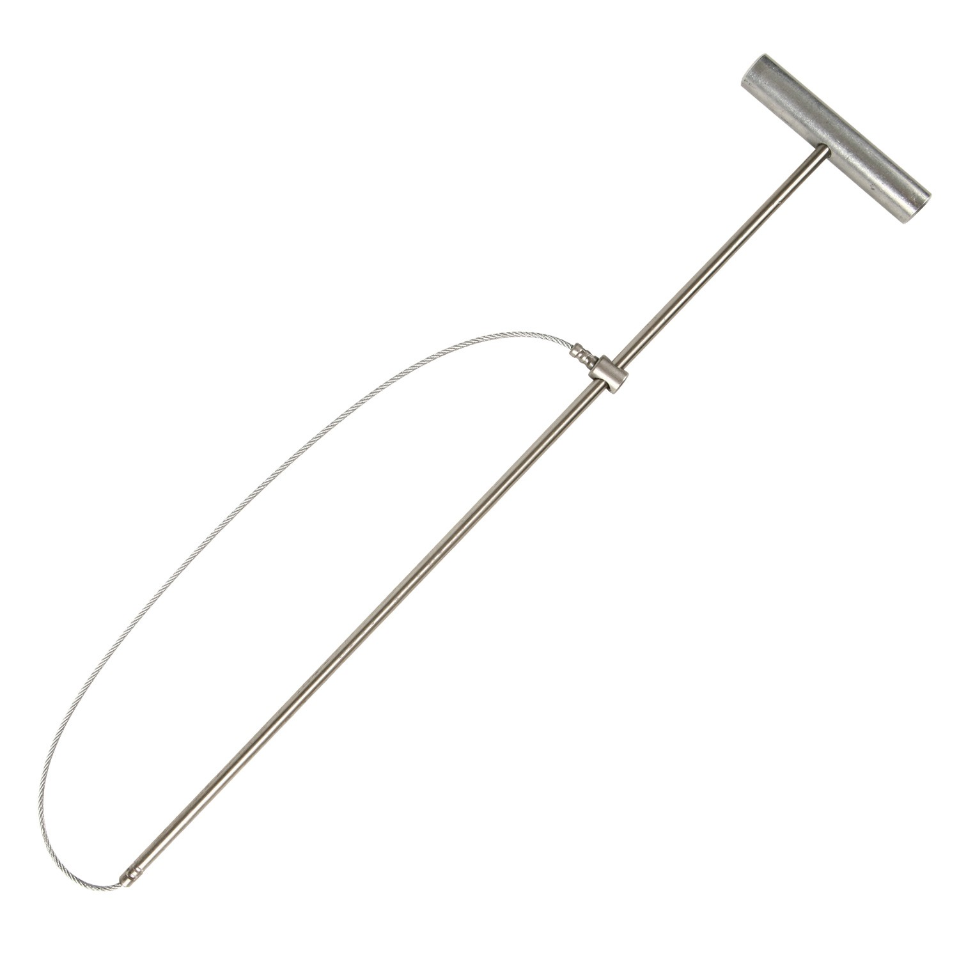
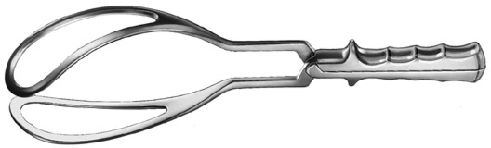
OB Snare and OB Forceps
An OB snare and OB forceps are tools utilized during farrowing.
If the sow is having trouble, these tools can provide assistance to remove piglets.
NOTE: You should have practice using these before as you could harm the sow and/or the piglet if used improperly.

Slide 9
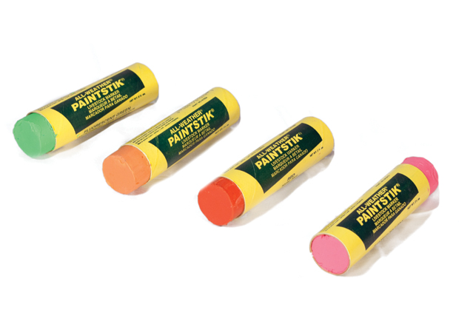
Livestock Marking Crayons/Paint Stick
In order to identify which pigs have been treated in a facility, farmers may use a livestock marking crayon, or paint stick, to identify the animals.

Slide 10
Ear Tagger
Some shows or events may require an ear tag as an additional form of identification.
The ear tagger is shown below with some examples of ear tags.
An Ear Tagger is used to put tags in pigs ears.
Ear Tags are used to identify pigs.

Slide 11
Show Tools: Pipe/Whip
When showing in the ring, you want to use a driving utensil that is familiar to the pig.
You want to have control of your animal.
Some animals respond better to whips, and some respond better to pipes.
The pipe and the whip are the most common types of driving utensils in the swine industry.

Slide 12
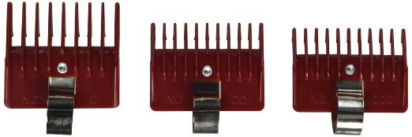
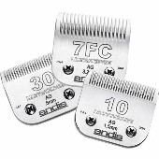
Clippers
Clippers
You want to make sure your pig is presented
properly on show day.
By using clippers such as these in addition to various head guards, you can trim your pig’s hair and make your project ready for the winner’s circle.
Be sure to check any hair length requirements before trimming your pigs for specific upcoming shows.
Clipper Blades
Head Guards

Slide 13
Nipple Water
Nipple waters are used as a way to provide continuous clean drinking water for pigs.
Keeping your pigs hydrated is a key component to their growth and success in the show ring.

Slide 14
Respiratory Mask
These respiratory masks can be worn when entering swine facilities.
These can prevent the transmission of zoonotic diseases and is a necessary precaution, especially in large swine operations.
These masks can also prevent the
inhalation of dust and other substances
that could be harmful.

Slide 15
Herder/Sorting Board
Herder boards (sorting boards) can be used to help with stubborn or difficult pigs.
They can help load pigs on the trailer or separate pigs from fighting in the ring.
Many people who work the ring
at shows carry a herder board to
assist them in penning pigs, separating
fights, and keeping pigs out of corners.

Slide 16
Plastic Boots
When entering swine facilities, it is important to wear these plastic boots.
These help prevent the spread of disease from operation to operation.
Wearing these boots is a good way to
practice sound herd health management and biosecurity.

Slide 17
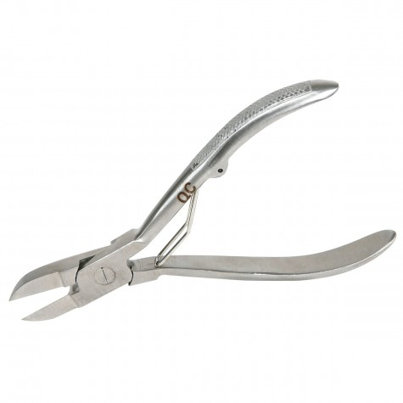
Tooth Nippers
When processing a litter of pigs, it is important to clip the needle teeth and clip the tail.
By clipping the needle teeth, you are getting rid of four very sharp teeth that could cause the sow discomfort when nursing.
Tails are also docked so that they are not too long and get stepped on by the mother or the other piglets.
Tail docking is often accompanied with iodine as well to prevent infection.
A pair of tooth nippers such as this will serve
to clip the needle teeth and dock the tail.

Slide 18
Pig Snare
Sometimes, a snare is necessary to use in order to give a pig a shot or to trim difficult areas on your pig’s body when clipping for a show.
Pictured below is an example of a snare that could be used for such purposes.

Slide 19
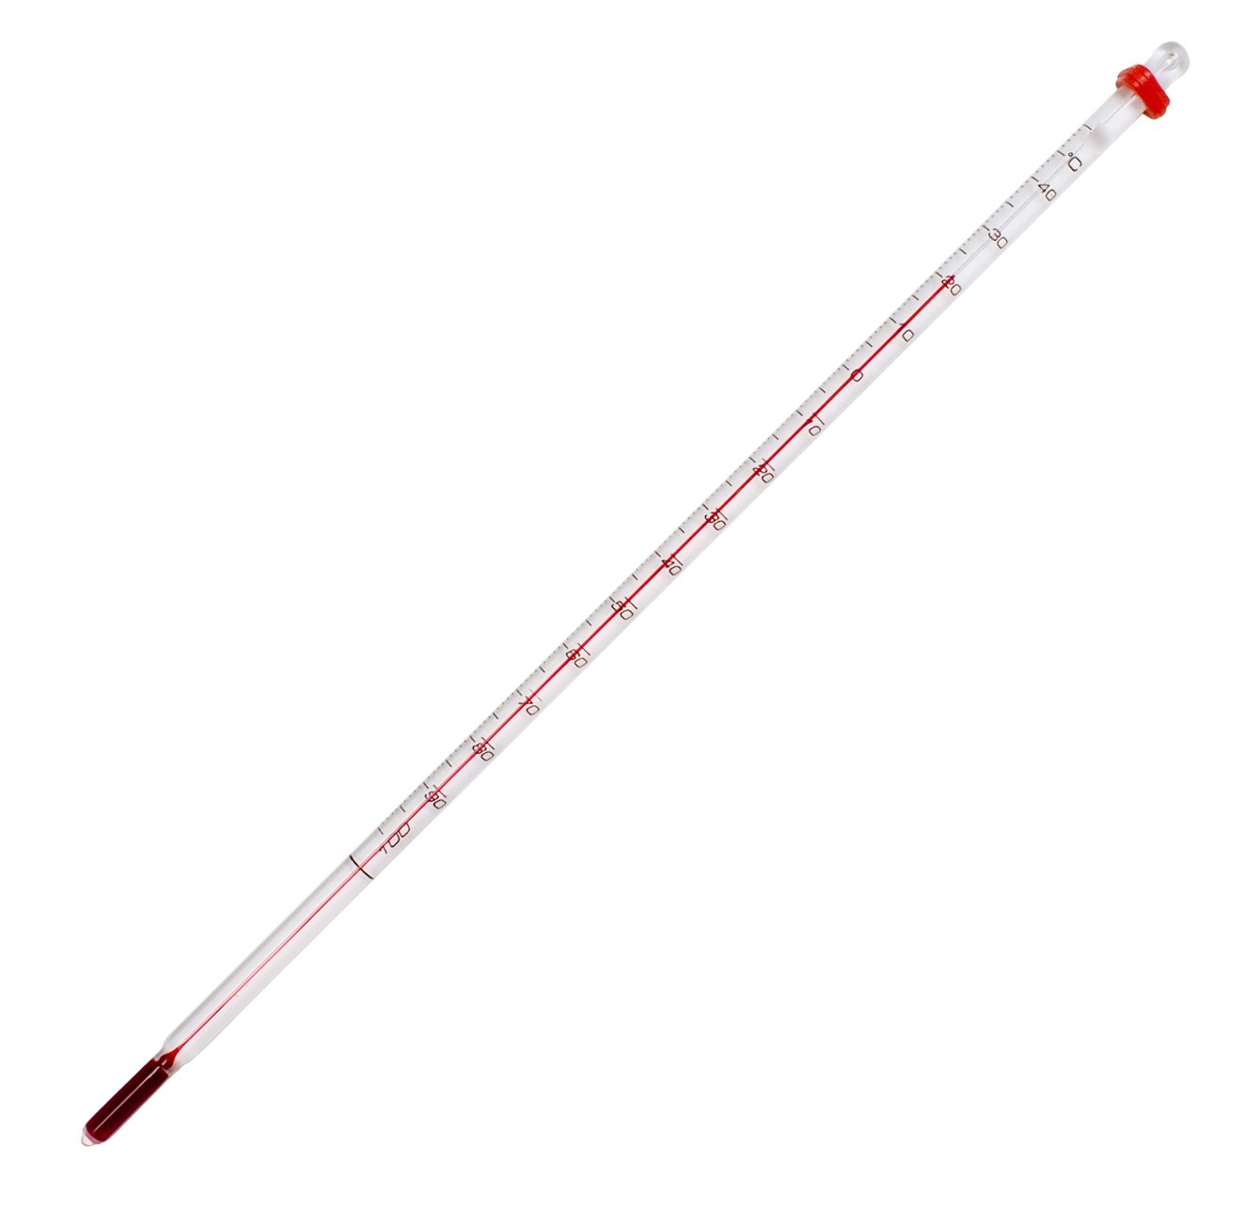
Thermometer
Thermometers such as this can be used to take your pig’s temperature when it may seem to be sick.
A normal temperature for a pig is between 101.5 and 102.5 degrees Fahrenheit.

Slide 20
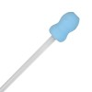
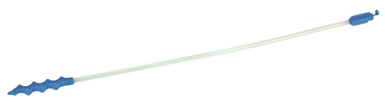
Artificial Insemination Breeding Rods
Artificial insemination rods, or spirettes, are used to inseminate a gilt or sow with boar semen.
When using the rod, it should be inserted at a slightly upward angle (45 degree angle) and be turned counterclockwise until it locks into the cervix. If using a foam tip rod, it does not need to be turned.
Once the breeding rod is locked into place, the semen tube can be placed in the tip of the rod.

Slide 21
Self Feeder
This is an examples of a type of self-feeder for swine.
Many hogs are put on a self-feeding diet, especially early in their life.
Through this, they have unlimited access
to food throughout the day.

Slide 22
KNOWLEDGE CHECK!
Complete the following quiz to see what you learned about tools and equipment in the swine industry.
Begin Quiz

Slide 23
1. What tool is pictured below?
Thermometer
Syringe
Spirette
Scalpel

Slide 24
TRY AGAIN!
Remember that this tool is used for artificial insemination. Which tool would be helpful in artificial insemination?
Back

Slide 25
CORRECT!
This is a spirette, otherwise known as an artificial insemination rod.
Next Question

Slide 26
2. You would primarily use a scalpel during _________.
Farrowing
Castrating
Weaning
Ear Notching

Slide 27
TRY AGAIN!
Think about what each of these tools would be used for. Remember a scalpel is like a small surgical knife.
Back

Slide 28
CORRECT!
A scalpel would be used in castration. Good work!
Next Question

Slide 29
3. What should be placed in the image below?
Used Plastic Boots
Old Feed
Used Needles
Trash

Slide 30
CORRECT!
Used needles should be placed in a puncture-proof sharps container. This prevents the spread of disease and infection and prevents injury from needles.
Next Question

Slide 31
TRY AGAIN!
Think about what you would place in these containers!
Back

Slide 32
4. Which tool is an ear notcher?

Slide 33
TRY AGAIN!
Go back and review the tools and equipment if needed!
Back

Slide 34
CORRECT!
Great Job!
You correctly selected the ear notcher!
Next Question

Slide 35
5. Which of the following helps prevent the spread of disease and/or infection?
Wearing plastic boots
Using a respiratory mask
Spraying iodine on docked tails
All of these options help with prevention.

Slide 36
TRY AGAIN!
This may be true…but read all of the choices!
Back

Slide 37
CORRECT!
Very Good!
All of these actions will help prevent disease and infection!
End Quiz

Slide 38
CONGRATULATIONS!
You completed the “Tools and Equipment”
Skillathon Resource!
Keep working hard to learn about the
Industry!

